Slide 1
CMSC 635 : DISCOVERY KNOWLEGDE & DATA MINING
BRIEF GUIDE FOR USING WEKA SOFTWARE

Slide 2
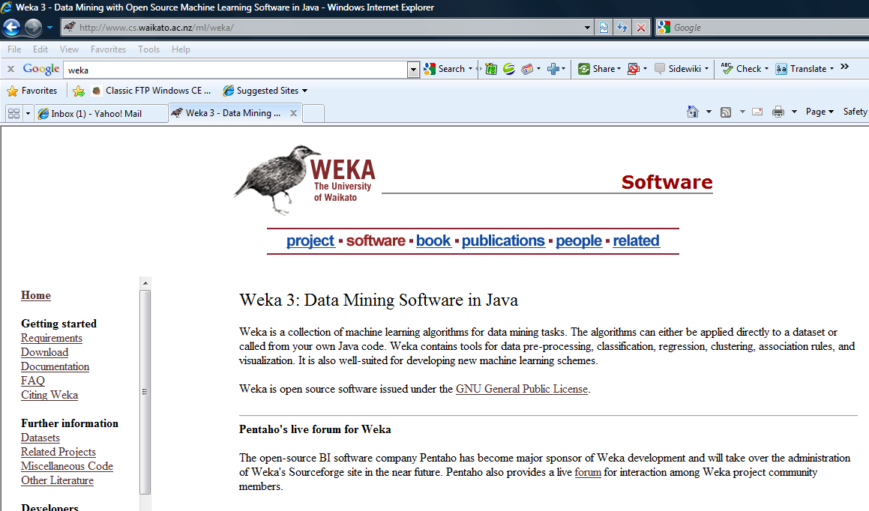
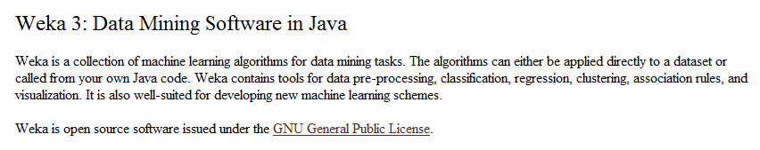
WEKA : Open Source Software for DataMining
Official website:
http://www.cs.waikato.ac.nz/ml/weka/
Attention: Have to install Java Runtime Environment before

Slide 3
WEKA : What we can do with ?
Weka is a piece of software, written in Java, that provides an array of machine learning tools, many of which can be used for data mining
    Pre-processing data
    Features selection
- Features extraction
    Regression
    Classify data
    Clustering data
    Associate rules
More functions
    Create random data set
    Connect data sets in other formats
    Visualize data
    …….

Slide 4
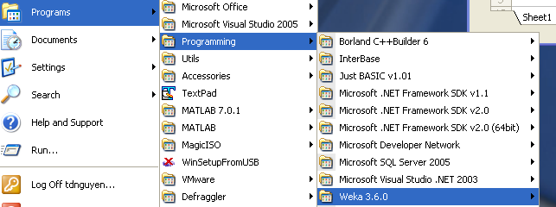
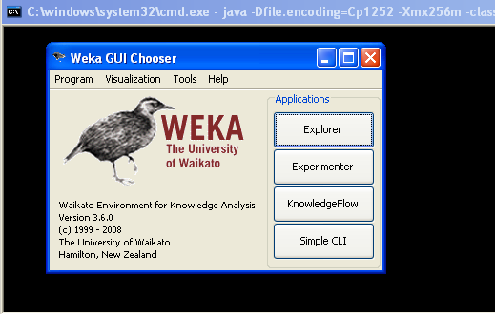
Running WEKA software (after installed)
Click button Explorer

Slide 5
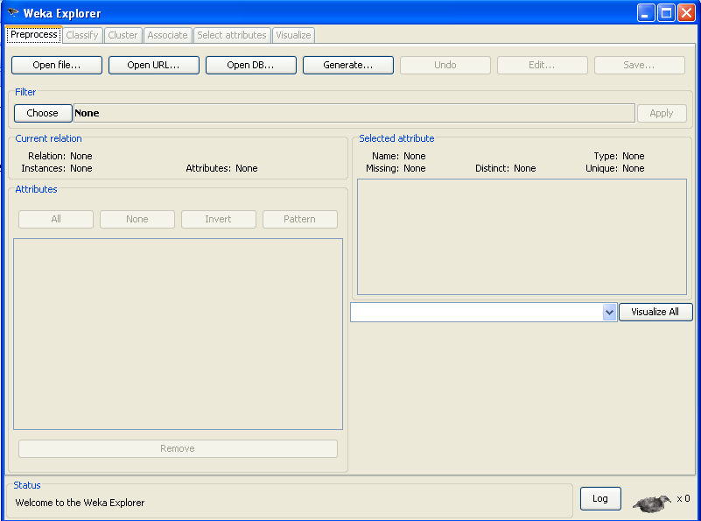
WEKA ‘s windows
Click here to open dataset file (.arff)

Slide 6
WEKA ‘s data file format
@relation iris
@attribute sepallength real
@attribute sepalwidth real
@attribute petallength real
@attribute petalwidth real
@attribute class {Iris-setosa, Iris-versicolor , Iris-virginica }
@data
5.1,3.5,1.4,0.2,Iris-setosa
4.9,3.0,1.4,0.2,Iris-setosa
6.4,2.8,5.6,2.1,Iris-virginica
5.0,3.6,1.4,0.2,Iris-setosa
7.0,3.2,4.7,1.4,Iris-versicolor
6.4,3.2,4.5,1.5,Iris-versicolor
6.4,2.8,5.6,2.1,Iris-virginica
6.9,3.1,4.9,1.5,Iris-versicolor
5.5,2.3,4.0,1.3,Iris-versicolor
5.4,3.9,1.7,0.4,Iris-setosa
6.4,2.8,5.6,2.1,Iris-virginica
4.8,3.0,1.4,0.3,Iris-setosa
6.2,2.8,4.8,1.8,Iris-virginica
6.1,3.0,4.9,1.8,Iris-virginica
Each attribute in each row with feature’s name and type
Each instance in each row, value list of features separated by comma

Slide 7
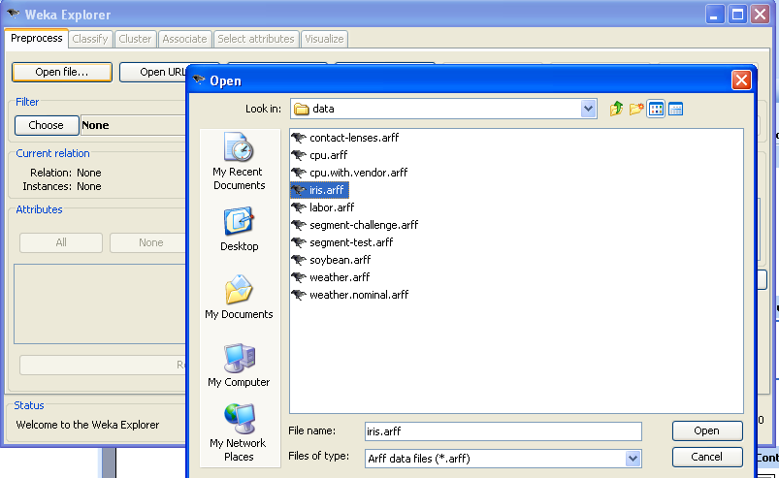
Select data file

Slide 8
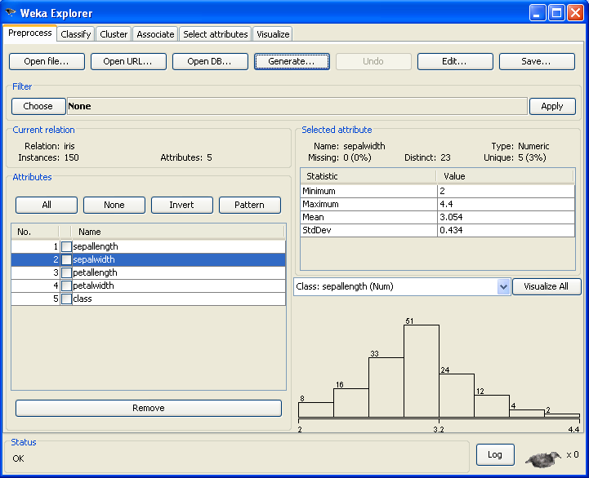
Dataset’s information
Features,
Instances,.
Feature’s
informations
Attributes’s list
Delete chosen features

Slide 9
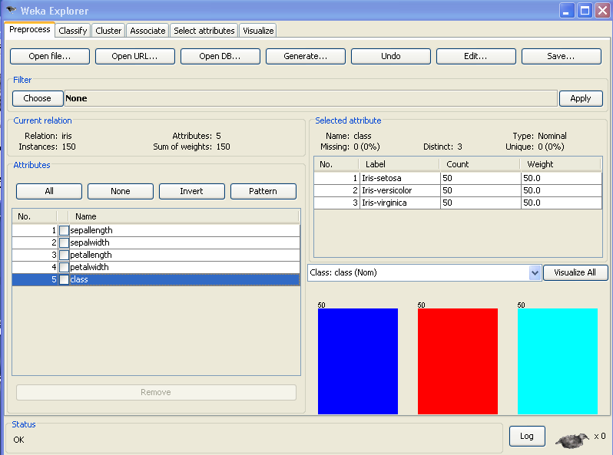
Dataset’s information

Slide 10
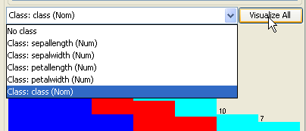
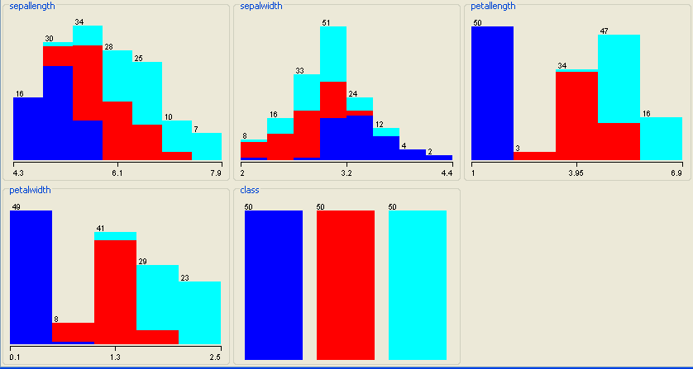

Slide 11
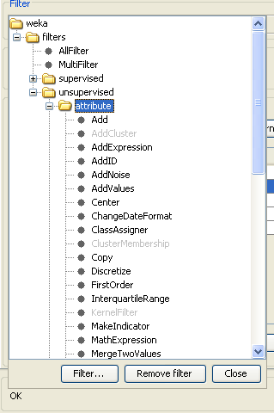
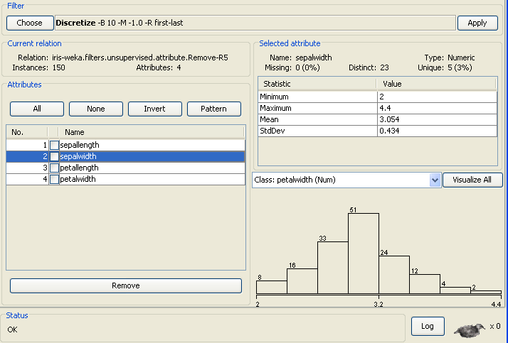
Preprocess data
Click Choose button
And choose wanted task. For example : Discretize

Slide 12
After choosing a task, click here to customize parameters
Click here !!!

Slide 13
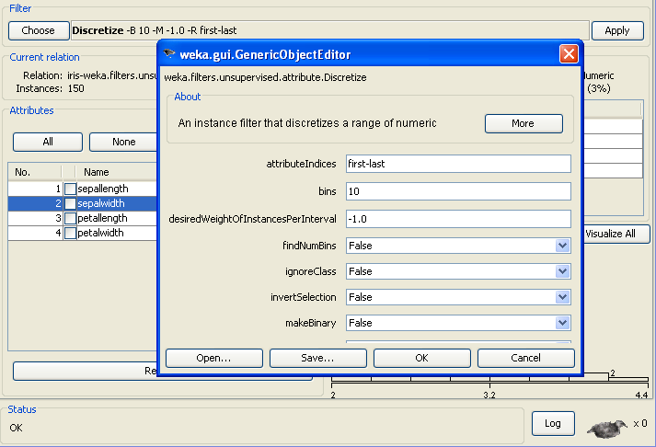
Adjust parameters’s value as you need
Click button Apply to run selected task

Slide 14
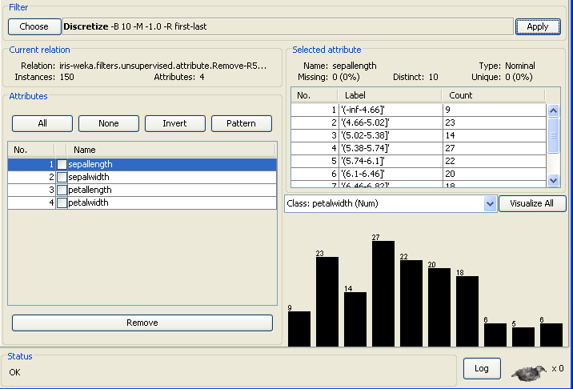
For example : results after discretized

Slide 15
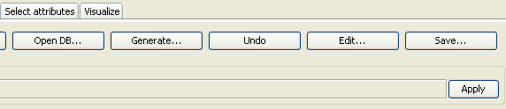
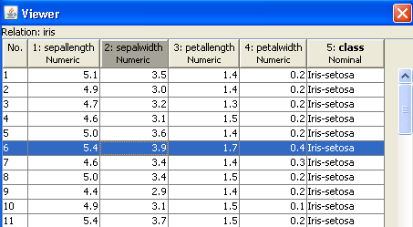
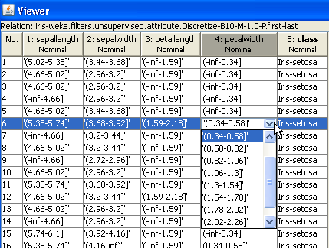
You can see, edit,… instances (any time)

Slide 16
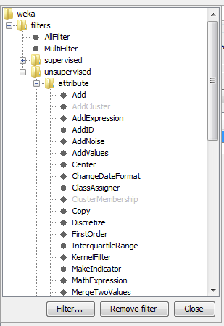
In Preprocess tab, you can select tasks such as
Discretize
Normalize
Remove feature
Add feature
Attribute selection
Convert numeric to binary, nomial
PCI
……

Slide 17
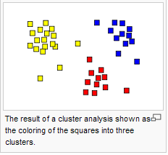
Clustering data
Task of assigning a set of objects into groups (called clusters) so that the objects in the same cluster are more similar (in some sense or another) to each other than to those in other clusters
- Open data set file (with or not class information)
- Pre-processing if needed
- Select Cluster tab

Slide 18
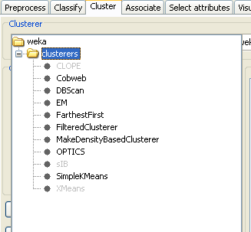
Tab Cluster : Clustering dataset with chosen method

Slide 19
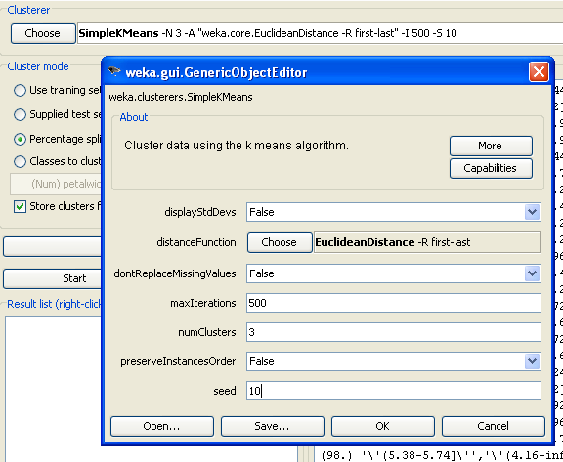
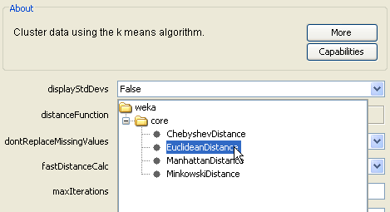
After choosing any task, click here to customize parameters

Slide 20
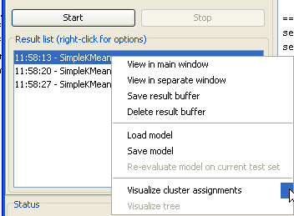
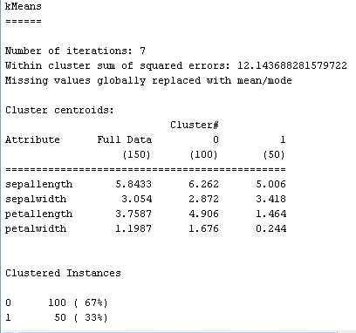
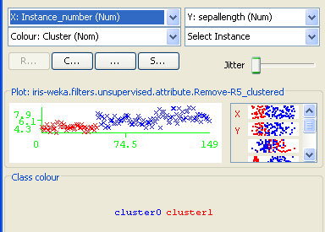
Clustering : Result depend on your selection !!
After tuning parameters, CLICK Start button to run
Right click here and choose Visualize cluster assignments

Slide 21
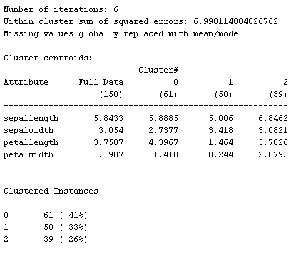
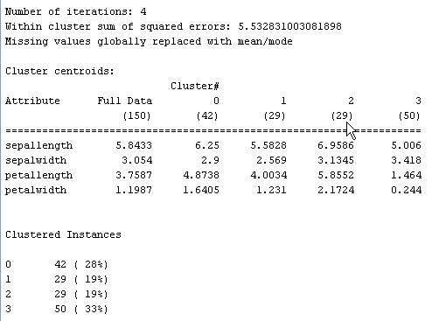
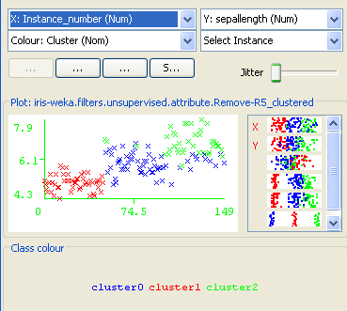
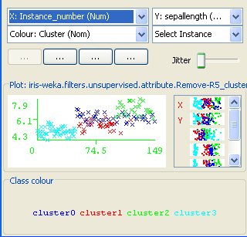
Result with 3 and 4 clusters

Slide 22
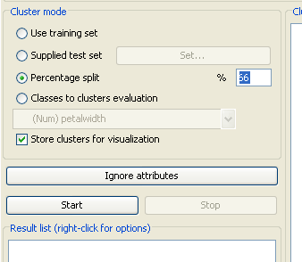
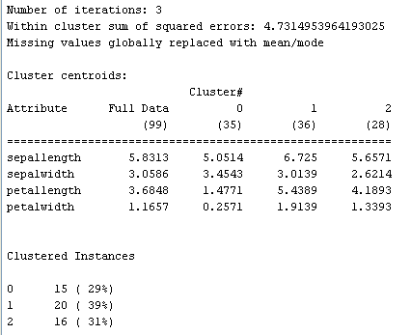
Choose testing dataset (no class information)
At last, click button Start : execute task

Slide 23
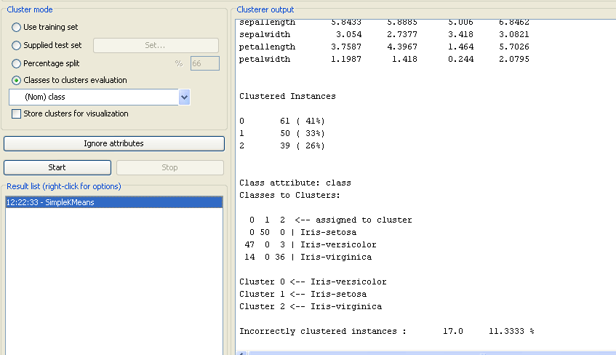
Testing dataset same as training set (with class information)
Select feature contains class name
Result after clustering
Result after testing

Slide 24
Classify data
Pls see Chapter 12 : Supervised Learning
( CMSC 635 ‘s website)
- Open data set file (with class information)
- Pre-processing if needed
- Select Classifytab

Slide 25
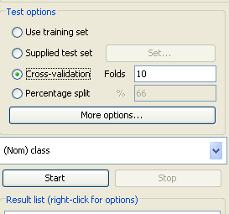
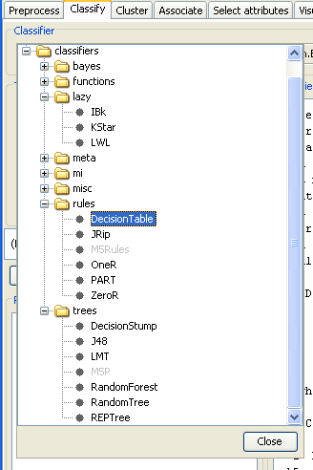
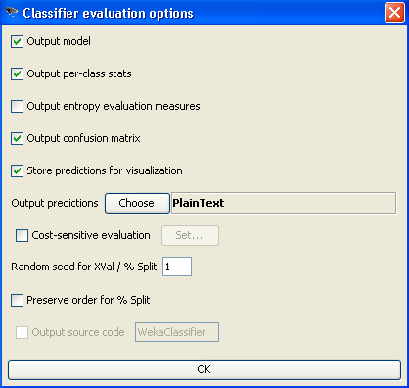
1- Click Choose button for selecting classifier
2- Select testing method (split, cross-validation,…)
3- Click More Options… if needed

Slide 26
Iris : Classifier Tree-J48, Percentage split 75% (25% for testing)
=== Run information ===
Scheme: weka.classifiers.trees.J48 -C 0.25 -M 2
Relation: iris
Instances: 150
Attributes: 5
sepallength
sepalwidth
petallength
petalwidth
class
Test mode: split 75.0% train, remainder test
=== Classifier model (full training set) ===
J48 pruned tree
------------------
petalwidth <= 0.6: Iris-setosa (50.0)
petalwidth > 0.6
| petalwidth <= 1.7
| | petallength <= 4.9: Iris-versicolor (48.0/1.0)
| | petallength > 4.9
| | | petalwidth <= 1.5: Iris-virginica (3.0)
| | | petalwidth > 1.5: Iris-versicolor (3.0/1.0)
| petalwidth > 1.7: Iris-virginica (46.0/1.0)
Number of Leaves : 5
Size of the tree : 9
Time taken to build model: 0 seconds

Slide 27
=== Predictions on test split ===
inst# actual predicted error prediction
1 2:Iris-ver 2:Iris-ver 0.971
2 3:Iris-vir 2:Iris-ver + 0.971
……………………………………………..
36 2:Iris-ver 2:Iris-ver 0.971
37 3:Iris-vir 3:Iris-vir 0.923
=== Evaluation on test split ===
=== Summary ===
Correctly Classified Instances 33 89.1892 %
Incorrectly Classified Instances 4 10.8108 %
Kappa statistic 0.8374
Mean absolute error 0.0892
Root mean squared error 0.257
Relative absolute error 20.0467 %
Root relative squared error 54.4579 %
Coverage of cases (0.95 level) 94.5946 %
Mean rel. region size (0.95 level) 45.045 %
Total Number of Instances 37
=== Detailed Accuracy By Class ===
TP Rate FP Rate Precision Recall F-Measure ROC Area Class
1 0 1 1 1 1 Iris-setosa
0.846 0.083 0.846 0.846 0.846 0.917 Iris-versicolor
0.846 0.083 0.846 0.846 0.846 0.917 Iris-virginica
Weighted Avg. 0.892 0.059 0.892 0.892 0.892 0.941
=== Confusion Matrix ===
a b c <-- classified as
11 0 0 | a = Iris-setosa
0 11 2 | b = Iris-versicolor
0 2 11 | c = Iris-virginica

Slide 28
Iris data : Classifier LibSVM, 10-cross validation
=== Run information ===
Scheme: weka.classifiers.functions.LibSVM -S 0 -K 2 -D 3 -G 0.0 -R 0.0 -N 0.5 -M 40.0 -C 1.0 -E 0.0010 -P 0.1 –
Relation: iris
Instances: 150
Attributes: 5
sepallength
sepalwidth
petallength
petalwidth
class
Test mode: 10-fold cross-validation
=== Classifier model (full training set) ===
LibSVM wrapper, original code by Yasser EL-Manzalawy (= WLSVM)
Time taken to build model: 0.02 seconds
=== Predictions on test data ===
inst# actual predicted error prediction
1 3:Iris-vir 3:Iris-vir 1
2 3:Iris-vir 3:Iris-vir 1
15 2:Iris-ver 3:Iris-vir + 1
1 3:Iris-vir 3:Iris-vir 1
2 3:Iris-vir 3:Iris-vir 1
3 3:Iris-vir 3:Iris-vir 1
14 2:Iris-ver 2:Iris-ver 1
15 2:Iris-ver 2:Iris-ver 1

Slide 29
=== Stratified cross-validation ===
=== Summary ===
Correctly Classified Instances 145 96.6667 %
Incorrectly Classified Instances 5 3.3333 %
Kappa statistic 0.95
Mean absolute error 0.0222
Root mean squared error 0.1491
Relative absolute error 5 %
Root relative squared error 31.6228 %
Coverage of cases (0.95 level) 96.6667 %
Mean rel. region size (0.95 level) 33.3333 %
Total Number of Instances 150
=== Detailed Accuracy By Class ===
TP Rate FP Rate Precision Recall F-Measure ROC Area Class
1 0 1 1 1 1 Iris-setosa
0.94 0.02 0.959 0.94 0.949 0.96 Iris-versicolor
0.96 0.03 0.941 0.96 0.95 0.965 Iris-virginica
Weighted Avg. 0.967 0.017 0.967 0.967 0.967 0.975
=== Confusion Matrix ===
a b c <-- classified as
50 0 0 | a = Iris-setosa
0 47 3 | b = Iris-versicolor
0 2 48 | c = Iris-virginica

Slide 30
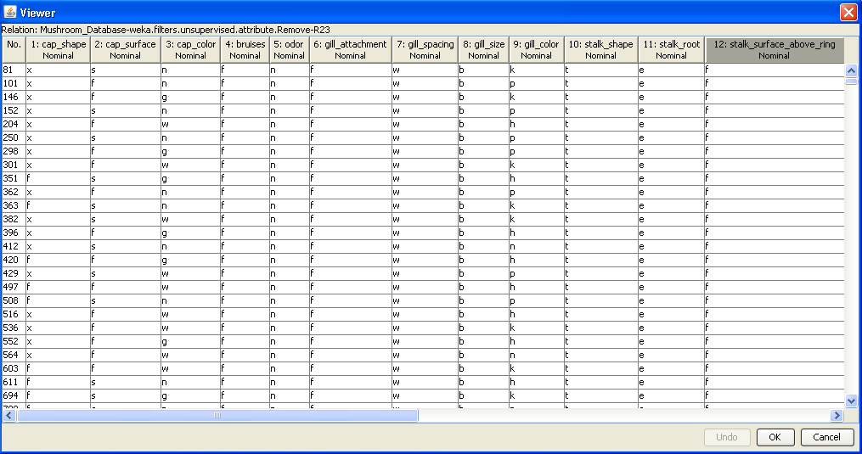
Associate Rules
Association rules mining is another, after clustering, key unsupervised data mining method that finds interesting associations (relationships, dependencies) in large sets of data items.
(see Chapter 10 – CMSC 635’s website)

Slide 31
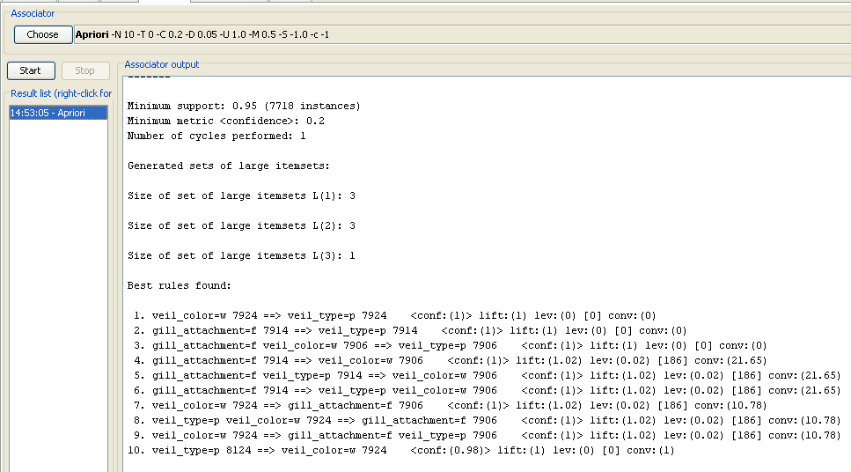
Mushroom data : Rule Associate

Slide 32
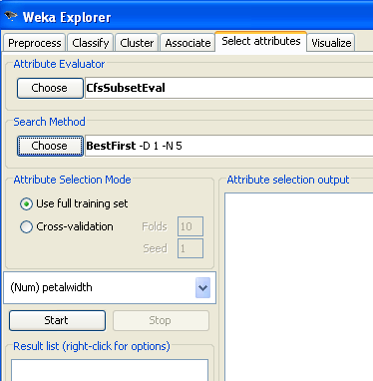
Tab Select attributes : Feature selection and extraction

Slide 33
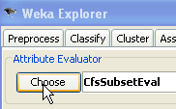
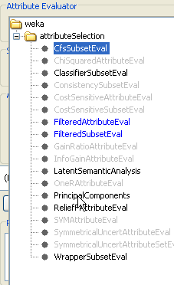
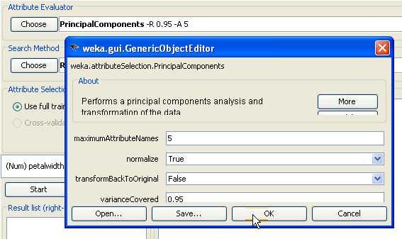
Feature extraction :

Slide 34
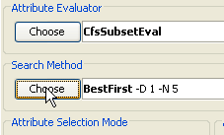
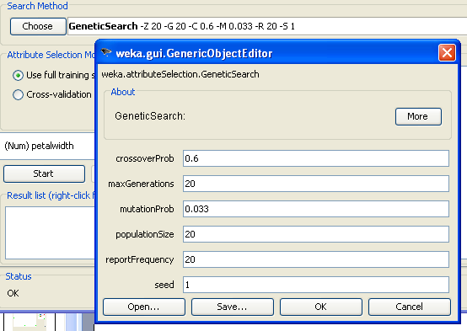
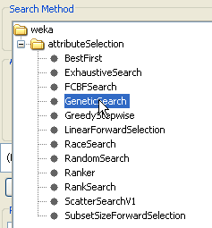
Feature selection :

Slide 35
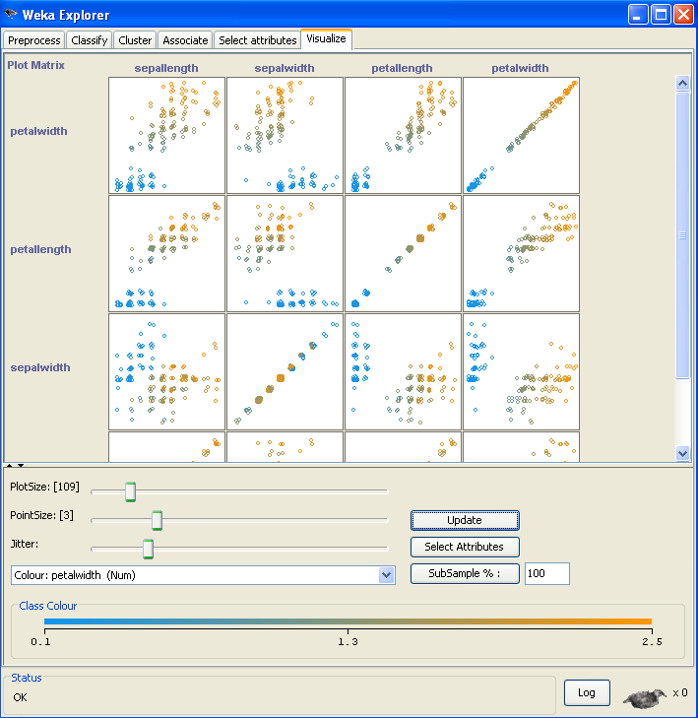

Tab Visualize : Graph between each pair of features

Slide 36
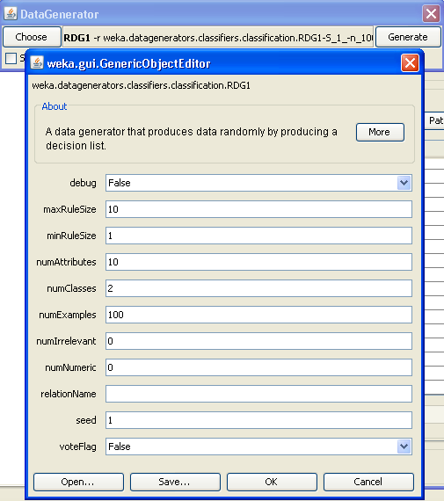
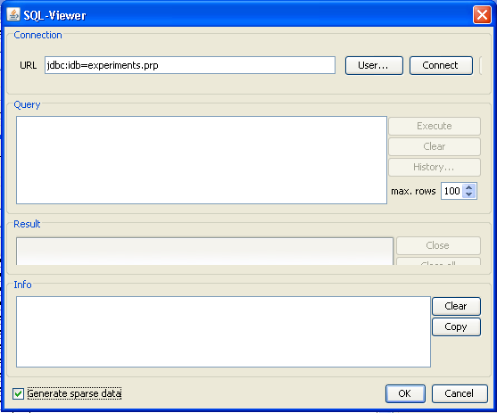
More functions in WEKA
Produces randomly data set :Generate… button (Preprocess tab)
Connect network data set : Open DB… button

Slide 37
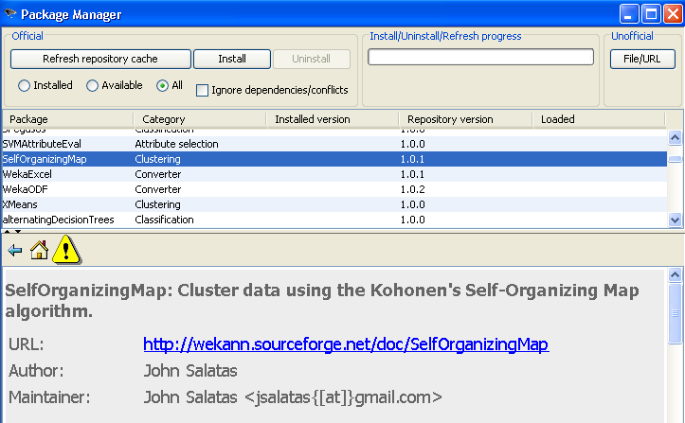
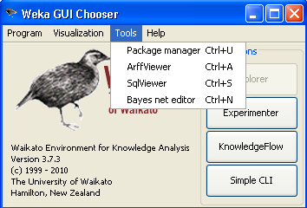
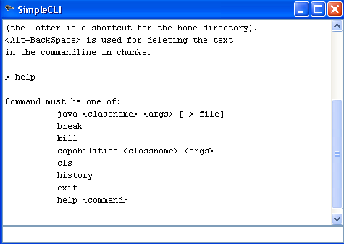
More functions in WEKA …
Manage packages in WEKA :
install, uninstall, informations,…
Run many data sets with
many algorithms
Run command directly

Slide 38
Note : You also use other tools for working with project (Matlab,….)
You can email to me if get troubles about WEKA software
      nguyendt22@vcu.edu
We will try running now !!!
Good luck

